Slide 1
Object Oriented Programming 2 Section 7
Unit 19: Layout Managers
Unit 20: GUI components : Labels, Buttons, TextComponents and Lists
Unit 21: Mouse and key events, JPanels
and paintComponent()

Slide 2
Overview of this Section
This section is provided to give you reference material on various GUI components and event types that you may need, via detailed sample programs
Most of the material comes from Deitel Ch 11
The important thing is to know what there is out there, and to be able to use these features when you need them, given some documentation on them

Slide 3
Examinable Objectives
Use the simpler components like labels, textfields, textarea and buttons within GUI applications
Achieve specific layout objectives by using layout managers and grouping components into panels
Describe how to deal with Mouse Events

Slide 4
Project-work objectives
Incorporate some of the more advanced components in applications you are building for projects

Slide 5
Unit 19: GUI Layout
Objectives:
Use layout managers and panels to arrange GUI components
Describe how FlowLayout works and use it
Describe how BorderLayout works and use it
Describe how GridLayout works and use it
Group components into JPanels for layout purposes
Use BoxLayout with a JTextArea

Slide 6
Reference Material
Deitel Ch 11 and the sample programs
FlowLayoutFrame and FlowLayoutDemo
BorderLayoutFrame and BorderLayoutDemo
GridLayoutFrame and GridLayoutDemo
PanelFrame and PanelDemo
TextAreaFrame and TextAreaDemo
Cadenhead Day 11, Farrell Ch 14

Slide 7
Layout Managers
Layout managers are provided to arrange GUI components in a container
Provide basic layout capabilities
Implement the interface LayoutManager

Slide 8
GUI design tools
Most Java programming environments provide GUI design tools that help a programmer design a GUI graphically; the design tools then write the Java code to create the GUI. Such tools often provide greater control over the size, position and alignment of GUI components than do the built-in layout managers.

Slide 9
null layout
It is possible to set a Container’s layout to null, which indicates that no layout manager should be used.
In a Container without a layout manager, the programmer must position and size the components in the given container using setBounds() and take care that, on resize events, all components are repositioned as necessary.
A component’s resize events can be processed by a ComponentListener.

Slide 10
FlowLayout
FlowLayout is the simplest layout manager
Components are placed left to right in order they are added
Components can be left aligned, centered or right aligned
It’s the default for a JPanel, but not for a JFrame

Slide 11
Layout managers.

Slide 12
FlowLayoutDemo
Adds 3 buttons to the content pane
Uses anonymous inner classes to process action handling (this was briefly mentioned in Unit 11 in connection with handling window events)
Concentrate on the layout implications, not the action handling issues

Slide 13
Outline
FlowLayoutFrame.java
Create FlowLayout
Set layout of application

Slide 14
Outline
Add JButton; FlowLayout will handle placement
FlowLayoutFrame.java
Set alignment to left
Adjust layout
Add JButton; FlowLayout will handle placement
Set alignment to center

Slide 15
Outline
Adjust layout
FlowLayoutFrame.java
Add JButton; FlowLayout will handle placement
Set alignment to right
Adjust layout

Slide 16


Outline
FlowLayoutDemo.java

Slide 17
BorderLayout
BorderLayout arranges components into five regions – north, south, east, west and center
Implements interface LayoutManager2
Provides horizontal gap spacing and vertical gap spacing
It’s the default for a Jframe
The demo program is its own action listener (see Unit 12)

Slide 18
One layout manager per container
Each container can have only one layout manager. Separate containers (different JPanels, for example) in the same application can use different layout managers.

Slide 19
Default for Border is Center
If no region is specified when adding a Component to a BorderLayout, the layout manager assumes that the Component should be added to region BorderLayout.CENTER.

Slide 20
Common Programming Error
When more than one component is added to a region in a BorderLayout, only the last component added to that region will be displayed. There is no error that indicates this problem.

Slide 21
Outline
BorderLayout Frame.java
Declare BorderLayout instance variable
Create BorderLayout
Set layout
Register event handler

Slide 22
Outline
BorderLayout Frame.java
Add buttons to application using layout manager constants
Make button invisible
Make button visible
Update layout

Slide 23
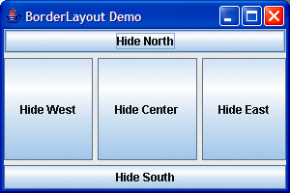
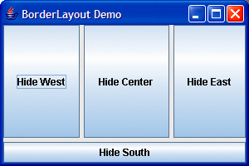
Outline
BorderLayout Demo.java
horizontal gap
vertical gap

Slide 24
GridLayout
GridLayout divides the container into a grid with rows and columns
Every component has the same width and height
Top row is filled first, then second row, etc
The demo uses 2 layouts, and a boolean attribute to keep track of which was last used and switch between them

Slide 25
Outline
GridLayout Frame.java
Declare two GridLayout instance variables
Create GridLayout
Set layout

Slide 26
Outline
Add button to JFrame
Use second layout
Use first layout
Update layout
GridLayout Frame.java

Slide 27
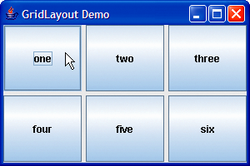
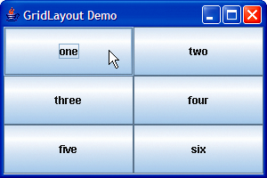
Outline
GridLayoutDemo.java

Slide 28
SpringLayout
A SpringLayout lays out the children of its associated container according to a set of constraints.
See ‘How to Use SpringLayout’ in The Java Tutorial for examples of using SpringLayout. There’s a link to the Java Tutorial on the opening page of the java docs, on the right at the top
Unlike many layout managers, SpringLayout doesn't automatically set the location of the components it manages.
If you hand-code a GUI that uses SpringLayout, remember to initialize component locations by constraining the west/east and north/south locations.

Slide 29
SpringLayout, more
Each constraint, represented by a Spring object, controls the vertical or horizontal distance between two component edges.
For example, the allowable width of a component can be expressed using a constraint that controls the distance between the west (left) and east (right) edges of the component.
The allowable y coordinates for a component can be expressed by constraining the distance between the north (top) edge of the component and the north edge of its container.

Slide 30
Using Panels to Manage More Complex Layouts
Complex GUIs often require multiple panels to arrange their components properly
The panels can then be added North, South etc
Remember to create the panel before trying to add components to it: if not, you will get a NullPointerException on running your program
JPanels can also be used for drawing: see Unit 21

Slide 31
Outline
PanelFrame.java
Declare a JPanel to hold buttons
Create JPanel
Set layout

Slide 32
Outline
Add button to panel
Add panel to application
PanelFrame.java

Slide 33
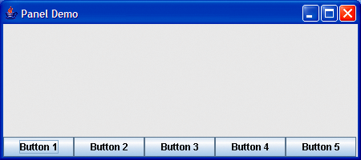
Outline
PanelDemo.java

Slide 34
JTextArea, Box and JScrollPane
JTextArea
Provides an area for manipulating multiple lines of text
JScrollPane is a pane with scrollbars that can be wrapped around a JTextArea
Box container
Subclass of Container
Uses a BoxLayout layout manager

Slide 35
Line-wrapping
To provide line-wrapping functionality for a JTextArea, invoke JTextArea method setLineWrap with a true argument.

Slide 36
Outline
TextAreaFrame .java
Declare JTextArea instance variables
Create a Box container
Create text area and add to box

Slide 37
Outline
Add button to box
TextAreaFrame .java
Copy selected text from one text area to the other
Create second text area and add it to box

Slide 38
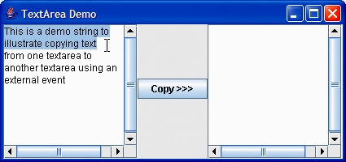
Outline
TextAreaDemo .java

Slide 39
Controlling scrollbars
When a JScrollPane has been wrapped around a JTextArea, you can control which scrollbars are displayed using the constants listed in ScrollPaneConstants.
Eg myScrollPane.setHorizontalScrollbarPolicy(
JScrollPane.
HORIZONTAL_SCROLLBAR_ALWAYS)

Slide 40
JScrollPane Scrollbar Policies
Horizontal policies
Always (HORIZONTAL_SCROLLBAR_ALWAYS)
As needed (HORIZONTAL_SCROLLBAR_AS_NEEDED)
Never (HORIZONTAL_SCROLLBAR_NEVER)
Vertical policies
Always (VERTICAL_SCROLLBAR_ALWAYS)
As needed (VERTICAL_SCROLLBAR_AS_NEEDED)
Never (VERTICAL_SCROLLBAR_NEVER)

Slide 41
Unit 20: GUI components : Labels, Buttons, TextComponents and Lists
Objectives: be able to
Build GUIs which include buttons, labels, lists and text components, and manipulate these components
Handle events generated by user interaction with buttons, labels, lists and text components.

Slide 42
Reference Material
Deitel Ch 11, and the sample programs:
LabelFrame, LabelFrameTest and bug.gif
TextFieldFrame and TextFieldTest
ButtonFrame and ButtonTest
CheckBoxFrame and CheckBoxTest
RadioButtonFrame and RadioButtonTest
ComboBoxFrame and ComboBoxTest
ListFrame and ListTest
MultipleSelectionFrame and Test
Various .gif files
Cadenhead Day 9, Farrell Ch 13

Slide 43
Some basic GUI components.

Slide 44
Swing vs. AWT
Abstract Window Toolkit (AWT)
Precursor to Swing
Declared in package java.awt
Does not provide consistent, cross-platform look-and-feel

Slide 45
Superclasses of Swing’s Lightweight GUI Components
Class Component (package java.awt)
Subclass of Object
Declares many behaviors and attributes common to GUI components
Class Container (package java.awt)
Subclass of Component
Organizes Components
Class JComponent (package javax.swing)
Subclass of Container
Superclass of all lightweight Swing components

Slide 46
Features of Swing’s Lightweight GUI Components
Pluggable look-and-feel to customize the appearance of components
Shortcut keys (called mnemonics)
Common event-handling capabilities
Brief description of component’s purpose (called tool tips)
Support for localization

Slide 47
Outline
LabelFrame.java

Slide 48
Outline
LabelFrame.java

Slide 49
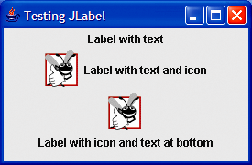
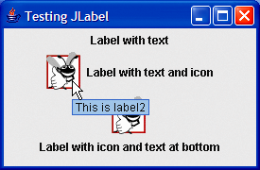
Outline
LabelTest.java

Slide 50
Creating and Attaching label1
Method setToolTipText of class JComponent
Specifies the tool tip
Method add of class Container
Adds a component to a container

Slide 51
Don’t forget to ‘add’
If you do not explicitly add a GUI component to a container, the GUI component will not be displayed when the container appears on the screen.
Use tool tips to add descriptive text to your GUI components. This text helps the user determine the GUI component’s purpose in the user interface.

Slide 52
Creating and Attaching label2
Interface Icon
Can be added to a JLabel with the setIcon method
Implemented by class ImageIcon
Interface SwingConstants
Declares a set of common integer constants such as those used to set the alignment of components
Can be used with methods setHorizontalAlignment and setVerticalAlignment

Slide 53
Creating and Attaching label3
Other JLabel methods
getText and setText
For setting and retrieving the text of a label
getIcon and setIcon
For setting and retrieving the icon displayed in the label
getHorizontalTextPosition and setHorizontalTextPosition
For setting and retrieving the horizontal position of the text displayed in the label

Slide 54
Some basic GUI constants.

Slide 55
Text Fields, PasswordFields
Class JTextComponent
Superclass of JTextField
Superclass of JPasswordField
Adds echo character to hide text input in component
Allows user to enter text in the component when component has the application’s focus
Sample program uses nested classes to handle actions

Slide 56
Outline
TextFieldFrame .java
Create a new JTextField

Slide 57
Outline
Create a new JTextField
TextFieldFrame .java
Create a new uneditable JTextField
Create a new JPasswordField
Create event handler
Register event handler
Create event handler class by implementing the ActionListener interface
Declare actionPerformed method

Slide 58
Outline
Test if the source of the event is the first text field
Get text from text field
Test if the source of the event is the second text field
Get text from text field
Test if the source of the event is the third text field
Get text from text field
Test if the source of the event is the password field
Get password from password field
TextFieldFrame .java

Slide 59
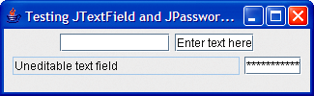
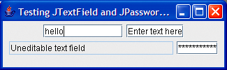
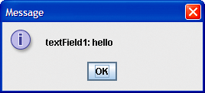
Outline
TextFieldTest .java

Slide 60
TextFieldHandler’s actionPerformed Method
Event source
Component from which event originates
Can be determined using method getSource
Text from a JTextField can be acquired using getActionCommand
Text from a JPasswordField can be acquired using getPassword

Slide 61
Common GUI Event Types and Listener Interfaces
Delegation event model
Event source is the component with which user interacts
Event object is created and contains information about the event that happened
Event listener is notified when an event happens

Slide 62
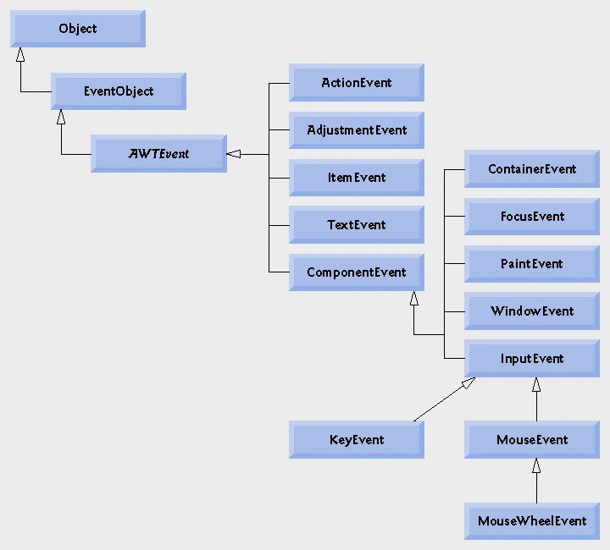
Some event classes of java.awt.event.

Slide 63
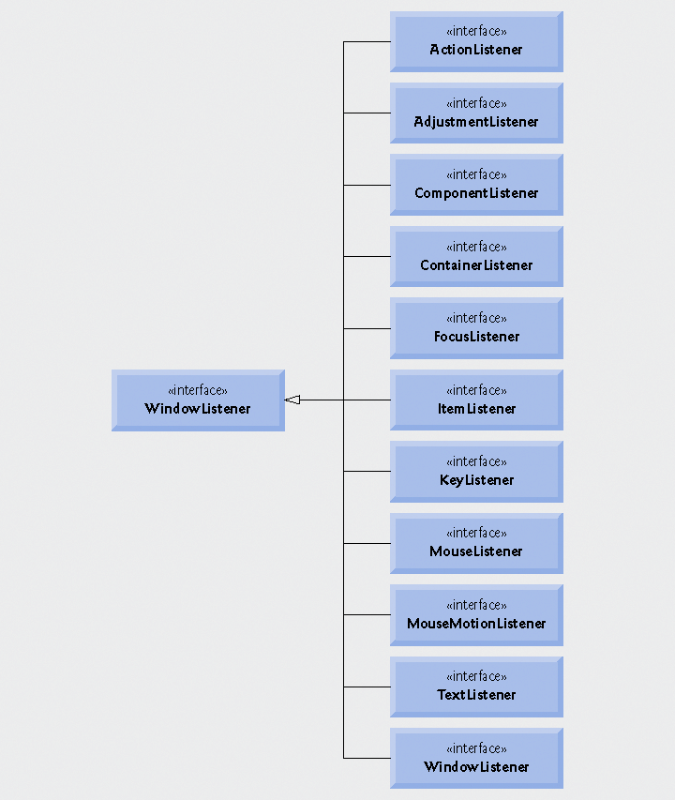
Some event-listener interfaces of java.awt.event.

Slide 64
Event-Handler Invocation
Events are dispatched to only the event listeners that match the event type
Events have a unique event ID specifying the event type
MouseEvents are handled by MouseListeners and MouseMotionsListeners
KeyEvents are handled by KeyListeners

Slide 65
JButton
Button
Component user clicks to trigger a specific action
Can be command button, check box, toggle button or radio button
Button types are subclasses of class AbstractButton

Slide 66
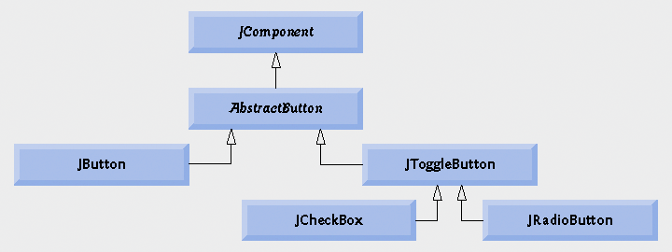
Swing button hierarchy.

Slide 67
Outline
ButtonFrame.java
Declare two JButton instance variables
Create new JButton
Create two ImageIcons
Create new JButton
Set rollover icon for JButton

Slide 68
Outline
Create handler for buttons
Register event handler
Inner class implements ActionListener
Access outer class’s instance using this reference
Get text of JButton pressed
ButtonFrame.java

Slide 69
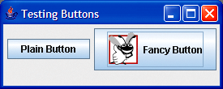
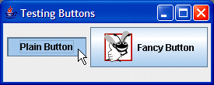
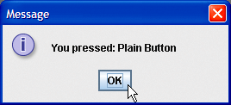
Outline
ButtonTest.java

Slide 70
JButton and rollover
JButtons can have a rollover icon
Appears when mouse is positioned over a button
Added to a JButton with method setRolloverIcon

Slide 71
rollover icons
Because class AbstractButton supports displaying text and images on a button, all subclasses of AbstractButton also support displaying text and images.
Using rollover icons for JButtons provides users with visual feedback indicating that when they click the mouse while the cursor is positioned over the button, an action will occur.

Slide 72
‘this’ and inner classes
When used in an inner class, keyword this refers to the current inner-class object being manipulated. An inner-class method can use its outer-class object’s this by preceding this with the outer-class name and a dot, as in ButtonFrame.this.

Slide 73
Buttons That Maintain State
Swing contains three types of state buttons
JToggleButton
JCheckBox
JRadioButton
JCheckBox and JRadioButton are subclasses of JToggleButton

Slide 74
JCheckBox
JCheckBox
Contains a check box label that appears to right of check box by default
Generates an ItemEvent when it is clicked
ItemEvents are handled by an ItemListener
Passed to method itemStateChanged
Method isSelected returns whether check box is selected (true) or not (false)

Slide 75
Outline
CheckBoxFrame .java
Declare two JCheckBox instance variables
Set font of text field

Slide 76
Outline
CheckBoxFrame .java
Create two JCheckBoxes
Create event handler
Register event handler with JCheckBoxes
Inner class implements ItemListener
itemStateChanged method is called when a JCheckBox is clicked
Test whether JCheckBox is selected

Slide 77
Outline
Test source of the event
isSelected method returns whether JCheckBox is selected
CheckBoxFrame .java

Slide 78
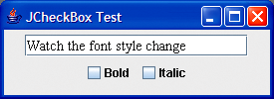
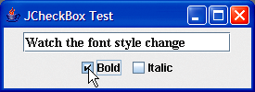
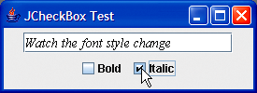
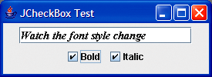
Outline
CheckBoxTest .java

Slide 79
JRadioButton
JRadioButton
Has two states – selected and unselected
Normally appear in a group in which only one radio button can be selected at a time
Group maintained by a ButtonGroup object
Declares method add to add a JRadioButton to group
Usually represents mutually exclusive options

Slide 80
Outline
RadioButtonFrame.java
Declare four JRadioButtons and a ButtonGroup to manage them

Slide 81
Outline
RadioButtonFrame .java
Create the four JRadioButtons
Create the ButtonGroup
Add each JRadioButton to the ButtonGroup

Slide 82
Outline
Register an event handler with each JRadioButton
RadioButtonFrame .java
Event handler inner class implements ItemListener
When radio button is selected, the text field’s font will be set to the value passed to the constructor

Slide 83
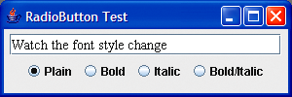
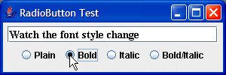
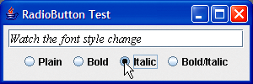
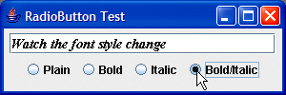
Outline
RadioButtonTest .java

Slide 84
JComboBox and Using an Anonymous Inner Class for Event Handling
Combo box
Also called a drop-down list
Implemented by class JComboBox
Each item in the list has an index
setMaximumRowCount sets the maximum number of rows shown at once
JComboBox provides a scrollbar and up and down arrows to traverse list

Slide 85
maximum row count
Set the maximum row count for a JComboBox to a number of rows that prevents the list from expanding outside the bounds of the window in which it is used. This configuration will ensure that the list displays correctly when it is expanded by the user.

Slide 86
Using an Anonymous Inner Class for Event Handling
Anonymous inner class
Special form of inner class
Declared without a name
Typically appears inside a method call
Has limited access to local variables
We saw this before in Unit 11

Slide 87
Outline
Declare JComboBox instance variable
ComboBoxFrame .java

Slide 88
Outline
Create JComboBox and set maximum row count
Create anonymous inner class as the event handler
Declare method itemStateChanged
Test state change of JComboBox
Method getSelectedIndex locates selected item
ComboBoxFrame .java

Slide 89
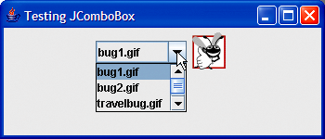
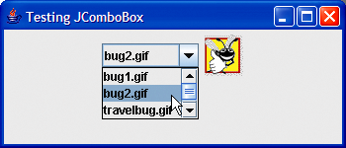
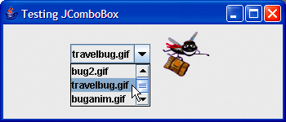
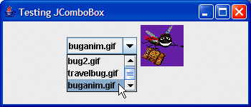
Outline
ComboBoxTest.java
Scrollbar to scroll through the
items in the list
scroll arrows
scroll box

Slide 90
JList
List
Displays a series of items from which the user may select one or more items
Implemented by class JList
Allows for single-selection lists or multiple-selection lists
A ListSelectionEvent occurs when an item is selected
Handled by a ListSelectionListener and passed to method valueChanged

Slide 91
JLists can be displayed in dialogs
It’s possible to show a JList within a message dialog: once the dialog has been dismissed, the getSelectedIndex() method allows the program to identify which item was selected by position in the list

Slide 92
Outline
ListFrame.java
Declare JList instance variable

Slide 93
Outline
Create JList
Set selection mode of JList
Add JList to ScrollPane and add to application
Get index of selected item
ListFrame.java

Slide 94
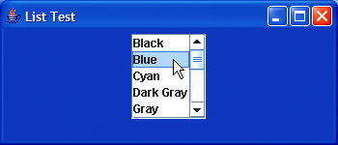
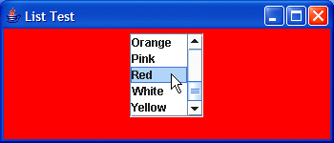
Outline
ListTest.java

Slide 95
Multiple-Selection Lists
Enable users to select many items
Single interval selection allows only a continuous range of items
Multiple interval selection allows any set of elements to be selected

Slide 96
Outline
Multiple SelectionFrame .java

Slide 97
Outline
Use a multiple interval selection list
Use methods setListData and getSelectedValues to copy values from one JList to the other
Multiple SelectionFrame .java

Slide 98
Outline
Set cell width for presentation
Set cell height for presentation
Set selection model to single interval selection
Multiple SelectionFrame .java

Slide 99
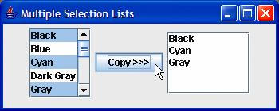
Outline
Multiple SelectionTest .java

Slide 100
Unit 21 Key-Event and Mouse-Event Handling
Objectives: be able to
Write GUI programs which capture and handle mouse events.
Write GUI programs which capture and handle keyboard events
Distinguish between MouseMotionListener and MouseListener
Use mouse adapter classes
Describe some of the methods in KeyListener

Slide 101
Reference Material
Deitel Ch 11, and the sample programs
KeyDemoFrame and KeyDemo
MouseTrackerFrame and MouseTracker
MouseDetailsFrame and MouseDetails
PaintPanel and Painter
Cadenhead Day 12, Wu section 14.8

Slide 102
Key Events
KeyListener interface
handles KeyEvents
Declares methods
keyPressed
keyReleased
keyTyped
Exercise: check it out in the doc files

Slide 103
Outline
KeyDemoFrame .java
Implement KeyListener interface
Set background color
Register application as event handler for itself

Slide 104
Outline
Declare keyPressed method
Get code of pressed key
Declare keyReleased method
Get code of released key
Declare keyTyped method
Output character typed
KeyDemoFrame .java

Slide 105
Outline
Test if it was an action key
Determine any modifiers pressed
KeyDemoFrame .java

Slide 106
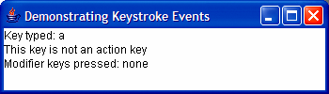
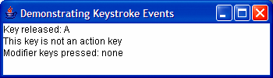
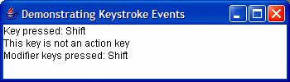

Outline
KeyDemo.java

Slide 107
Mouse Event Handling
Mouse events
Create a MouseEvent object
Handled by MouseListeners and MouseMotionListeners
MouseInputListener combines the two interfaces
Interface MouseWheelListener declares method mouseWheelMoved to handle MouseWheelEvents

Slide 108
MouseListener and MouseMotionListener interface methods, pt 1

Slide 109
MouseListener and MouseMotionListener interface methods, pt 2

Slide 110
Outline
MouseTrackerFrame.java
Create JPanel to capture mouse events
Set background to white
Create JLabel and add to application

Slide 111
Outline
Create event handler for mouse events
Register event handler
Implement mouse listener interfaces
Declare mouseClicked method
Find location of mouse click
Declare mousePressed method
MouseTrackerFrame.java
Declare mouseReleased method

Slide 112
Outline
Declare mouseEntered method
Set background of JPanel
Declare mouseExited method
Set background of JPanel
MouseTracker Frame.java

Slide 113
Outline
Declare mouseDragged method
Declare mouseMoved method
MouseTracker Frame.java

Slide 114
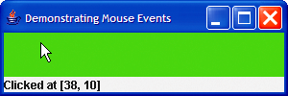
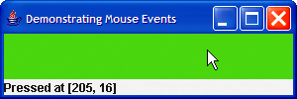
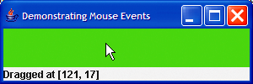
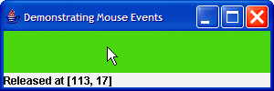
Outline
MouseTrackerFrame.java

Slide 115
Adapter Classes
Adapter class
Implements event listener interface
Provides default implementation for all event-handling methods
We met the WindowAdapter class in Unit 11/12, for simplifying handling windowClosing()

Slide 116
Extending MouseAdapter
MouseAdapter
Adapter class for MouseListener and MouseMotionListener interfaces
Extending class allows you to override only the methods you wish to use

Slide 117
Common Programming Error
If you extend an adapter class and misspell the name of the method you are overriding, your method simply becomes another method in the class. This is a logic error that is difficult to detect, since the program will call the empty version of the method inherited from the adapter class.

Slide 118
Event-adapter classes and the interfaces they implement in package java.awt.event.

Slide 119
Outline
MouseDetails Frame.java
Register event handler

Slide 120
Outline
Get number of times mouse button was clicked
Test for right mouse button
Test for middle mouse button
MouseDetails Frame.java

Slide 121
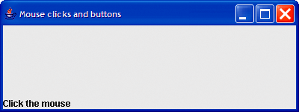
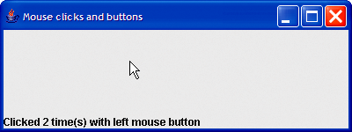
Outline
MouseDetails .java

Slide 122
InputEvent methods that help distinguish among left-, center- and right-mouse-button clicks.

Slide 123
JPanel Subclass for Drawing with the Mouse
Overriding class JPanel
Provides a dedicated drawing area
Method paintComponent
Draws on a Swing component
Overriding this method allows you to create custom drawings
Must call superclass method first when overridden

Slide 124
Opaque components
Most Swing GUI components can be transparent or opaque. If a Swing GUI component is opaque, its background will be cleared when its paintComponent method is called. Only opaque components can display a customized background color. JPanel objects are opaque by default.

Slide 125
Error-Prevention Tip
In a JComponent subclass’s paintComponent method, the first statement should always be a call to the superclass’s paintComponent method to ensure that an object of the subclass displays correctly.

Slide 126
Common Programming Error
If an overridden paintComponent method does not call the superclass’s version, the subclass component may not display properly. If an overridden paintComponent method calls the superclass’s version after other drawing is performed, the drawing will be erased.

Slide 127
Defining the Custom Drawing Area: PaintPanel.java
Customized subclass of JPanel
Provides custom drawing area
Class Graphics is used to draw on Swing components
Class Point represents an x-y coordinate

Slide 128
Outline
PaintPanel.java
Create array of Points

Slide 129
Outline
Anonymous inner class for event handling
Override mouseDragged method
Get location of mouse cursor
Repaint the JFrame
PaintPanel.java
Get the x and y-coordinates of the Point

Slide 130
Clearing the background
Calling repaint for a Swing GUI component indicates that the component should be refreshed on the screen as soon as possible. The background of the GUI component is cleared only if the component is opaque. JComponent method setOpaque can be passed a boolean argument indicating whether the component is opaque (true) or transparent (false).

Slide 131
Origin is top left
Drawing on any GUI component is performed with coordinates that are measured from the upper-left corner (0, 0) of that GUI component, not the upper-left corner of the screen.

Slide 132
Outline
Painter.java
Create instance of custom drawing panel

